Slide 1
8254 Counter/Timer

Slide 2
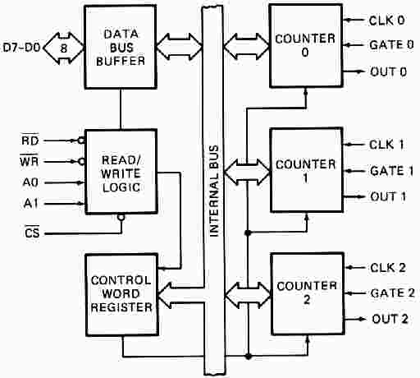
8254 Counter

Slide 3
Each of the three counter has 3 pins associated
CLK: input clock frequency- 8 MHz
OUT
GATE: Enable (high) or disable (low) the counter

Slide 4
Each of the three counters must be programmed separately
Control byte must be first written into the control register. The 8253/54 must be initialized before use
The programmer can not only write the value of the count into the 8253/54, but read the content of the counter at any given time as well
All counters are down counters

Slide 5
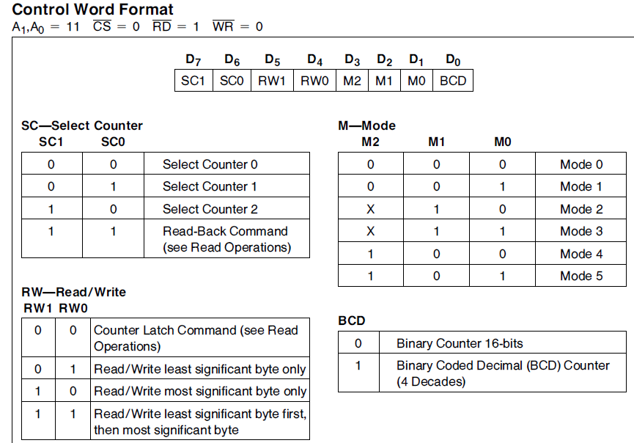
Control Word of 8254

Slide 6
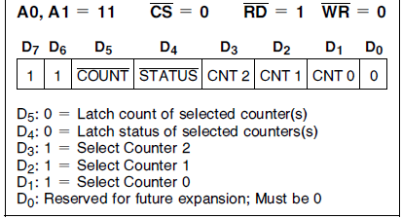
Read-back control word

Slide 7
Mode-0
Mode 0: Interrupt on terminal count
The output is initially low, and remain low for the duration of the count
if GATE=1. When the terminal count is reached, the output will go high and remain high until a new control word or new count number is loaded
Width of low pulse = N * T, where T is clock period
If GATE becomes low at the middle of the count, the count will stop
and the output will be low. The count resumes when the GATE
becomes high again This in effect adds to the total time the output is low

Slide 8
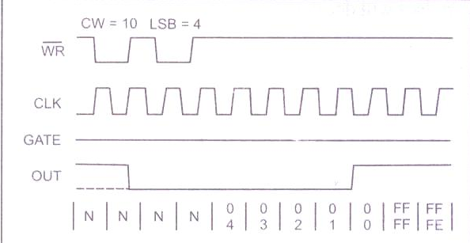
Mode 0

Slide 9
Mode 1
Mode 1: HW triggered
The triggering must be done through the GATE input by sending a 0-to-1 pulse to it.
Steps: 1) Load the count register
2) A 0-to-1 pulse must be sent to the GATE input to trigger the count
In Mode 1, after sending the 0-to-1 pulse to GATE, OUT becomes low and stays low for a duration of N*T, then becomes high and stays high until the GATE is triggered again
If during the activation, a retriggered happened, then restart the down counting

Slide 10
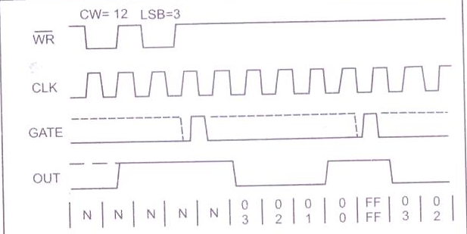
Mode 1

Slide 11
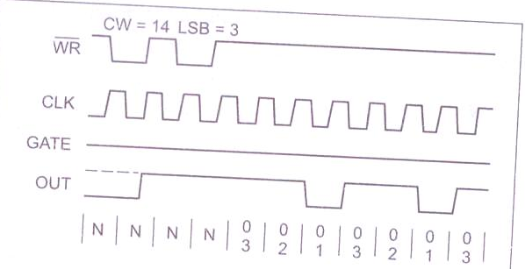
Mode 2
Mode 2: Rate Generator
In Mode2, if GATE=1, OUT will be high until the count reaches 1 and then OUT goes low only for one clock pulse, then counter is reloaded automatically, and the process continues indefinitely.

Slide 12
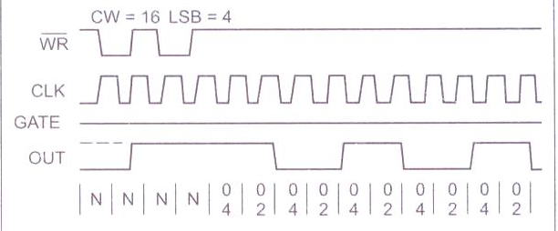
Mode-3
Mode 3: Square wave generator
When count is loaded and gate=1, the output is high and the count is decremented by two at every clock cycle and when it reaches zero, the output goes low and the count is reloaded again.

Slide 13
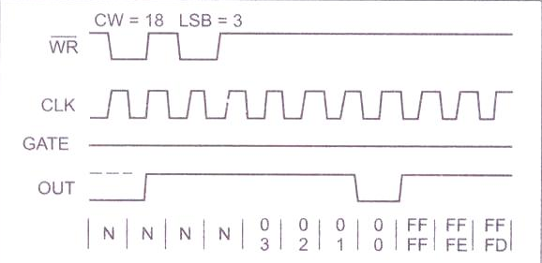
mode-4
Mode 4: Software triggered strobe
Similar to Mode2, except that the counter is not reloaded automatically
In Mode4, if GATE=1, the output will go high when loading the count,it will stay high for duration N*T. After the count reaches zero, it becomes low for one clock pulse, then goes high again and stays high until a new command word or new count is loaded
To repeat the strobe, the count must be reloaded

Slide 14
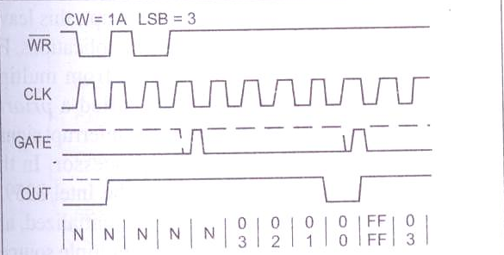
Mode-5
Mode 5: Hardware triggered strobe
Similar to Mode4, except that the triggering must be done with the GATE input
The count starts only when a 0-to-1 pulse is sent to the GATE input
If GATE retriggered during the counting, it will restart the down counting

